Slide 1
Content, Assessment and Pedagogy (CAP): An Integrated Design Approach
Instructional Team:
Ruth Streveler, Karl Smith & Rocío Chavela
2009 Workshop for
The Committee for the Formation of Engineers Puebla-Tlaxcala
Session 2 – July 1, 2009

Slide 2
Backward Design Approach
Yesterday: Desired Results (Outcomes, Objectives, Learning Goals)
5 minute university
Today: Evidence (Assessment)
Learning Taxonomies
Tomorrow: Plan Instruction
Engage Students

Slide 3
The Key Components of INTEGRATED COURSE DESIGN
A Self-Directed Guide to Designing Courses for Significant Learning
L. Dee Fink. 2003. Creating significant learning experiences. Jossey-Bass.

Slide 4
Session 2 Overview
Welcome & Overview
Minute Paper for Session 1
Most important thing you learned; muddiest point
Student Learning Outcomes Development
Refining outcomes
Assessing Student Learning
Use of Taxonomies
Assignments & Next Steps

Slide 5
Minute Paper about Session 1
Reflect on session 1.
On one side of an index card answer this question: What is the most important thing you learned yesterday?
On the side of the index card answer this question: What is still confusing or unclear?
Talk with other members of your group. Share with the large group.
Collect individual cards.

Slide 6
Taxonomies:Think-Pair-Share
What is a taxonomy?
What is a learning taxonomy?
Why might learning taxonomies be useful?

Slide 7
Taxonomies
Bloom’s taxonomy of educational objectives: Cognitive Domain (Bloom & Krathwohl, 1956)
A taxonomy for learning, teaching, and assessing: A revision of Bloom’s taxonomy of educational objectives (Anderson & Krathwohl, 2001).
Facets of understanding (Wiggins & McTighe, 1998)
Taxonomy of significant learning (Dee Fink, 2003)

Slide 8
The Six Major Levels of Bloom's (1956)Taxonomy of the Cognitive Domain (with representative behaviors and sample objectives)
Knowledge. Remembering information Define, identify, label, state, list, match
Identify the standard peripheral components of a computer
Write the equation for the Ideal Gas Law
Comprehension. Explaining the meaning of information Describe, generalize, paraphrase, summarize, estimate
In one sentence explain the main idea of a written passage
Describe in prose what is shown in graph form
Application. Using abstractions in concrete situations Determine, chart, implement, prepare, solve, use, develop
Using principles of operant conditioning, train a rate to press a bar
Derive a kinetic model from experimental data

Slide 9
The Six Major Levels of Bloom's Taxonomy of the Cognitive Domain (with representative behaviors and sample objectives)
Analysis. Breaking down a whole into component parts Points out, differentiate, distinguish, discriminate, compare
Identify supporting evidence to support the interpretation of a literary passage
Analyze an oscillator circuit and determine the frequency of oscillation
Synthesis. Putting parts together to form a new and integrated whole Create, design, plan, organize, generate, write
Write a logically organized essay in favor of euthanasia
Develop an individualized nutrition program for a diabetic patient
Evaluation. Making judgments about the merits of ideas, materials, or phenomena Appraise, critique, judge, weigh, evaluate, select
Assess the appropriateness of an author's conclusions based on the evidence given
Select the best proposal for a proposed water treatment plant

Slide 10
Cognitive Process Dimension
Lower Order Skills
Remember
Recognizing
Recalling
Understand
Interpreting
Exemplifying
Summarizing
Comparing
Explaining
Apply
Executing
Implementing
Higher Order Skills
Analyze
Differentiating
Organizing
Attributing
Evaluate
Checking
Critiquing
Create
Generating
Planning
Producing

Slide 12
A taxonomy for learning, teaching, and assessing: A revision of Bloom’s taxonomy of educational objectives (Anderson & Krathwohl, 2001).
The Knowledge Dimension
Factual Knowledge
Conceptual Knowledge
Procedural Knowledge
Metacognitive Knowledge

Slide 14
The taxonomy table
The Knowledge Dimension | The Cognitive Process Dimension
 | 1. Remember | 2. Understand | 3. Apply | 4. Analyze | 5. Evaluate | 6. Create
A. Factual Knowledge
B. Conceptual Knowledge
C. Procedural Knowledge
D. Metacognitive Knowledge
(Anderson & Krathwohl, 2001)

Slide 15
Facets of Understanding Wiggins & McTighe, 1998, page 44
When we truly understand, we
Can explain
Can interpret
Can apply
Have perspective
Can empathize
Have self-knowledge

Slide 16
Sample Learning Objectives (Wiggins & McTighe, p. 87, 154)
Facet 1: Explanation
Student will be able to explain that the gravitational force is an attraction between masses and that the strength of the force is proportional to the masses and weakens rapidly with increasing distance between them
Facets 2-3-1: Interpretation-Application-Explanation
Apply the practice of statics (physics) to the practice of statics (physics). Build a balsa bridge to specifications in which the situational demands require adjustments to the mathematically predicted answers.

Slide 17
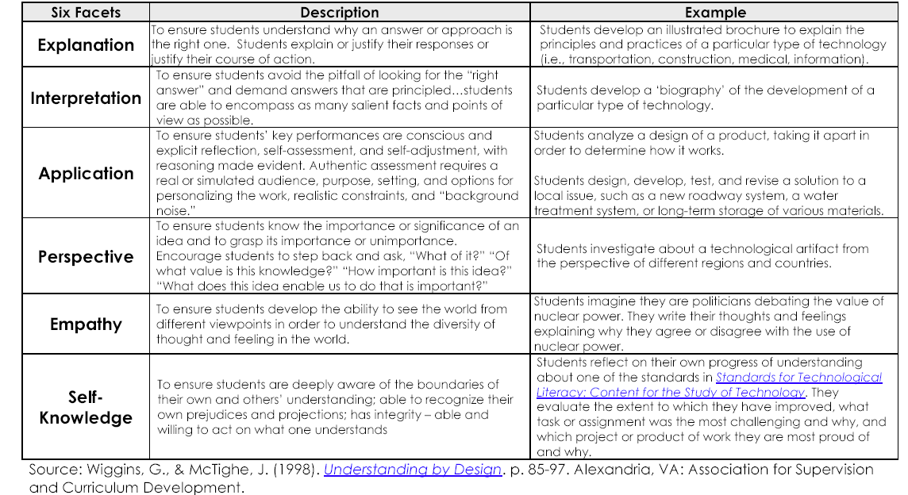
Six Facets of understanding

Slide 18
Creating Significant Learning Experiences A TAXONOMY OF SIGNIFICANT LEARNING - Dee Fink

Slide 19
Creating Significant Learning Experiences A TAXONOMY OF SIGNIFICANT LEARNING - Dee Fink
Page 9

Slide 20
Fink - Step 2. Worksheet (p. 11)
Individually complete all the applicable categories
Share with your neighbors

Slide 21
Refining your learning objectives
Individually take a couple of minutes to review your current learning goals.
Share your draft with your neighbors.
Provide feedback to your neighbors’ drafts too.
How will you assess whether your learning goals have been achieved?
CAP - 21
Notes:
21

Slide 22
Some Important Principles About Learning and Understanding
.
A third critical idea about how people learn is that a “metacognitive” approach to instruction can help students learn to take control of their own learning by defining learning goals and monitoring their progress in achieving them.
Jim Pellegrino – Rethinking and redesigning curriculum, instruction and assessment: What contemporary research and theory suggests

Slide 23
Understanding Understanding
Stage 1. Identify Desired Results
Focus Question: What does it mean to “understand”?
Stage 2. Determine Acceptable Evidence
Focus Questions: “How will we know if students have achieved the desired results and met the standards? What will we accept as evidence of student understanding and proficiency (Wiggins & McTighe)

Slide 24
Minute Paper Results Most Important
Prioritizing the objectives
The CAP (backward design) model
Working with (and agreeing with) people from other universities
Importance of acknowledging the values and other affective outcomes, and not only the cognitive outcomes

Slide 25
Minute Paper Results Most Confusing
How to place things in the “onion” diagram
How to write learning objectives, how to know if they are right and enough
How this process improves the course/syllabus {Instructional team – especially student learning}
Assessment Techniques & Pedagogy Examples
CAP elements and how they align
How to complete the Fink Table 1
How to incorporate the “whole person” outcomes

Slide 26
Some Important Principles About Learning and Understanding
The first important principle about how people learn is that students come to the classroom with preconceptions about how the world works which include beliefs and prior knowledge acquired through various experiences.
Jim Pellegrino – Rethinking and redesigning curriculum, instruction and assessment: What contemporary research and theory suggests

Slide 27
Understanding Misunderstanding
A Private Universe – 21 minute video available from www.learner.org
Also see Minds of our own (Annenberg/CPB Math and Science Collection – www.learner.org)
Can we believe our eyes?
Lessons from thin air
Under construction
Teaching Teaching & Understanding Understanding - http://www.daimi.au.dk/~brabrand/short-film/index-gv.html

Slide 28
Understanding Misunderstanding
Common misunderstandings or misconceptions among students in your course
Individually reflect
Share with others

Slide 29
Backward Design
Stage 2. Determine Acceptable Evidence
Types of Assessment (Wiggins & McTighe, p. 14)
Quiz and Test Items:
Simple, content-focused test items
Academic Prompts:
Open-ended questions or problems that
require the student to think critically
Performance Tasks or Projects:
Complex challenges that mirror the issues or
problems faced by graduates, they are authentic

Slide 30
Worksheet for Designing a Course/Class Session/Learning Module
 | Ways of Assessing | Actual Teaching-Learning | Helpful Resources:
Learning Goals for Course/Session/Learning Module: | This Kind of Learning: | Activities: | (e.g., people, things)
1.
2.
3.
4.
5.
6.

Slide 31
Course Concept Mapping
Construct a concept map (visual organizer) that represents the key elements and relationships between these key elements for the course you are re-designing
Notes:
31

Slide 32
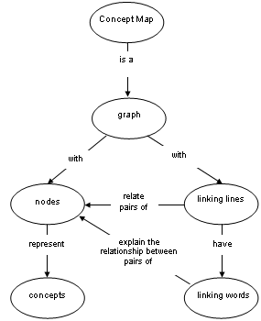
How to construct a concept map
Central Node
BIG idea at the heart of the discipline
Most important outcome for the course
Surrounding Nodes
Related ideas, topics, etc.
Nature of the connection (relationship) between the nodes
Ruíz-Primo, M. (2000). On the use of concept maps as an assessment tool in science: What we have learned so far. Revista Electrónica de Investigación Educativa, 2 (1).

Slide 33
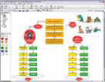
Concept Maps Software Tools
Cmap Tools (http:// cmap.ihmc.us)
Institute for Human &Machine Cognition
Free downloadable program
C-Tools (http://ctools.msu.edu)
Michigan State University (NSF)
Free web-based Java applet
SMART Ideas (http://www2.smarttech.com)
SMART Tech
Free trial version (30 days)

Slide 34
Visual Organizer
Share your elaborated concept map or other visual organizer with your neighborhood. Get feedback from your neighbors.
Participants may have a chance to share their concept map with the another group.

Slide 35
Backward Design Approach
Desired Results (Outcomes, Objectives, Learning Goals)
5 minute university
Evidence (Assessment)
Learning Taxonomies
Plan Instruction
Engage Students

Slide 36
Worksheet for Designing a Course/Class Session/Learning Module
 | Ways of Assessing | Actual Teaching-Learning | Helpful Resources:
Learning Goals for Course/Session/Learning Module: | This Kind of Learning: | Activities: | (e.g., people, things)
1.
2.
3.
4.
5.
6.

Slide 37
Backward Design
Plan Learning Experiences & Instruction
What enabling knowledge (facts, concepts, and principles) and skills (procedures) will students need to perform effectively and achieve desired results?
What activities will equip students with the needed knowledge and skills?
What will need to be taught and coached, and how should it be taught, in light of performance goals?
What materials and resources are best suited to accomplish these goals?
Is the overall design coherent and effective?
CAP - 37

Slide 38
Assignments & Next Steps
For tomorrow
Revise the assessment column of your worksheet
Begin to plan Instruction
See questions on previous slide

